Slide 1


Beautiful interlinks in credit scoring
by Yuriy Strilets
VP, Credit Risk Modeling at Bank Austria, Unicredit Group
2017
This disclaimer informs readers know that the views, thoughts, and opinions expressed in the text belong solely to the author, and not necessarily to the Bank Austria and Unicredit Group in the whole.

Slide 2

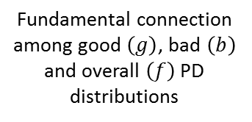
Agenda
Gini & KS: graphical and analytical interconnections
Fundamental connection among good $\left(g\right)$, bad $\left(b\right)$ and overall $\left(f\right)$ PD distributions
Life-time loss structure
Gini and KS as functions of $f$
Concept of PD distribution
Expected Loss bias remedy
Calibration & Gini

Slide 3





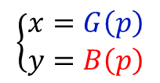



Gini & KS: graphical interconnection
$$B\left(p\right)$$
$$y$$
ROC curve defined parametrically:
$$\left\{\begin{aligned}x=G\left(p\right) \\ y=B\left(p\right)\end{aligned}\right.$$
$$p$$
$$x$$
$$G\left(p\right)$$
$$p$$
$$p$$

Slide 4









Gini & KS: graphical interconnection
$$y$$
$$Gini∈$$
$$\left(KS;(2−KS)∙KS\right)$$
$$KS$$
$$G\left(p\right)$$
$$max$$
$$max$$
$$KS$$
$$KS$$
“worst“ convex ROC s.t. KS
“best“ ROC s.t. KS
$$p$$
$$x$$
$$Gini∈$$
$$\left({KS}^{2};(2−KS)∙KS\right)$$
$$μ_{1}$$
$$KS$$
$$G\left(p\right)$$
“worst“ quasi-convex ROC s.t. KS
“best“ ROC s.t. KS
$$p$$
$$p$$

Slide 5
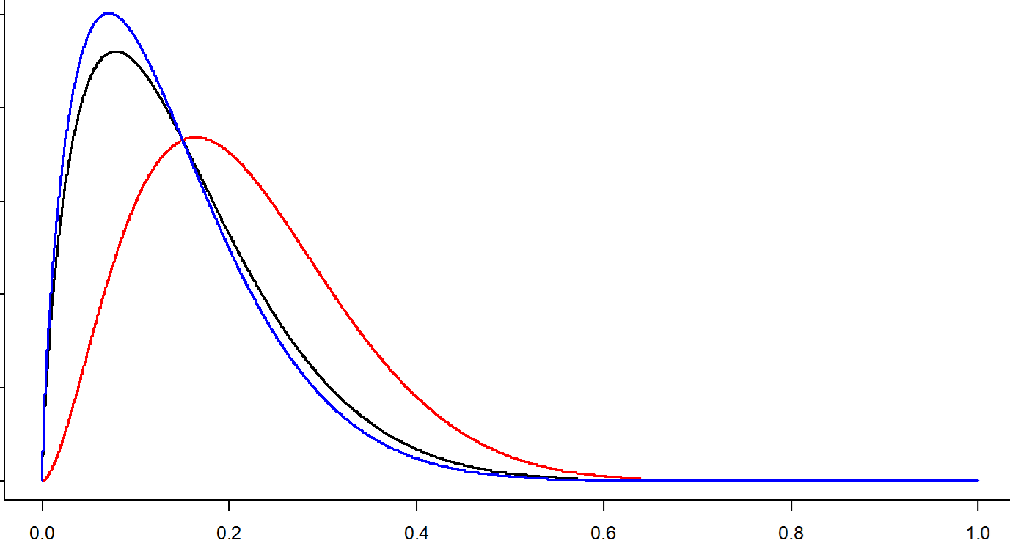

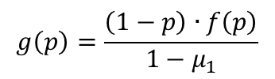
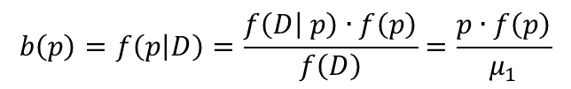


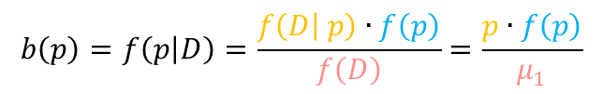






Fundamental connection among good (𝑔), bad (𝑏) and overall (𝑓) PD distributions
$$g$$
$$f$$
$$f$$
$$?$$
$$b$$
$$g$$
$$b$$
$$μ_{1}$$
$$b\left(p\right)=f\left(p | D\right)=\frac{f\left(D | p\right)∙f\left(p\right)}{f\left(D\right)}=\frac{p∙f\left(p\right)}{μ_{1}}$$
$$b\left(p\right)=f\left(p | D\right)=\frac{f\left(D | p\right)∙f\left(p\right)}{f\left(D\right)}=\frac{p∙f\left(p\right)}{μ_{1}}$$
$$g\left(p\right)=\frac{\left(1−p\right)∙f\left(p\right)}{{1−μ}_{1}}$$
$$f=μ_{1}∙b+\left(1−μ_{1}\right)∙g$$

Slide 6
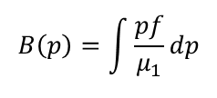
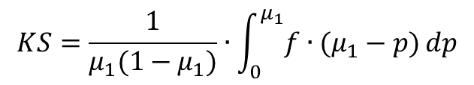

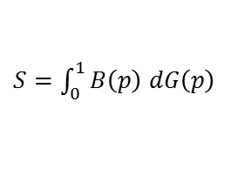
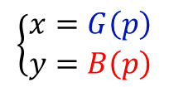


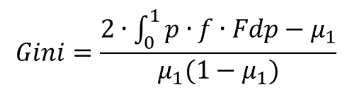



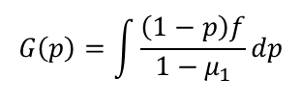

Gini and KS as functions of 𝑓
$$\left\{\begin{aligned}x=G\left(p\right) \\ y=B\left(p\right)\end{aligned}\right.$$
$S=\int_{0}^{1}{B\left(p\right)}$ $dG\left(p\right)$
$$=\frac{\left(\frac{1}{2}−S \right)}{\frac{1}{2}}$$
$$Gini$$
$$B\left(p\right)=\int{\frac{pf}{μ_{1}}dp}$$
$$S$$
$$G\left(p\right)=\int{\frac{\left(1−p\right)f}{{1−μ}_{1}}dp}$$
$$Gini=\frac{2∙\int_{0}^{1}{p∙f∙Fdp−μ_{1}}}{μ_{1}(1−μ_{1})}$$
$$⇒$$
$$⇒$$
$$KS=\frac{1}{μ_{1}(1−μ_{1})}∙\int_{0}^{μ_{1}}{f∙(μ_{1}−p)}dp$$
NB: if$p\sim Beta\left(α,β\right)$, then
$$Gini=−0.7125∙{KS}^{2}+1.7881∙KS−0.0594$$
$${(R}^{2}=0.9999)$$

Slide 7

Gini “natural” fluctuation
Gini fluctuation subject to number of Obs
$\left(μ_{1}=2.5\%,Gini=54\%\right)$
number of observations in sample
1. To form a belief about $μ_{1}$ and intrinsic model $Gini$ (e.g., = $Gini$from development sample)
2. From $\left(μ_{1}, Gini\right)$ we uniquely derive parameters of corresponding Beta distribution (here assume: $p\sim Beta\left(α,β\right)$)
3. To draw from defined Beta distribution a sample of PD’s of size $n$ (i.e., size of our working validation sample)
4. To simulate outcomes (0,1) from sampled PD’s
5. To estimate Gini (as we have vector of PD’s and vector of realized outcomes)
6. To repeat 2-4 many times and to estimate Gini distribution and its respective percentiles

Slide 8

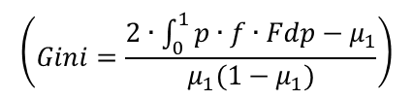

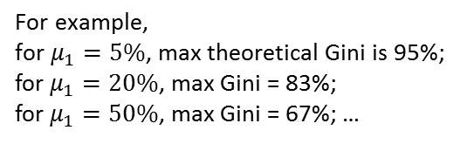
Max theoretical values of Gini
$$\left(Gini=\frac{2∙\int_{0}^{1}{p∙f∙Fdp−μ_{1}}}{μ_{1}(1−μ_{1})}\right)$$
maximize
$$\left\{\begin{aligned}p\sim Beta\left(α,β\right) \\ f is unimodal \\ average PD\text{ =}{ μ}_{1}\end{aligned}\right.$$
subject to:
$$⇒ \text{solution}: \left\{\begin{aligned}α^{∗}=\frac{μ_{1}}{1−μ_{1}} \\ β^{∗}=1 \end{aligned}\right.$$
$$\text{For} \text{example}\text{, }$$
$\text{for} μ_{1}=5\%$, max theoretical Gini is 95%;
for $μ_{1}=20\%$, max Gini = 83%;
for $μ_{1}=50\%$, max Gini = 67%; …

Slide 9

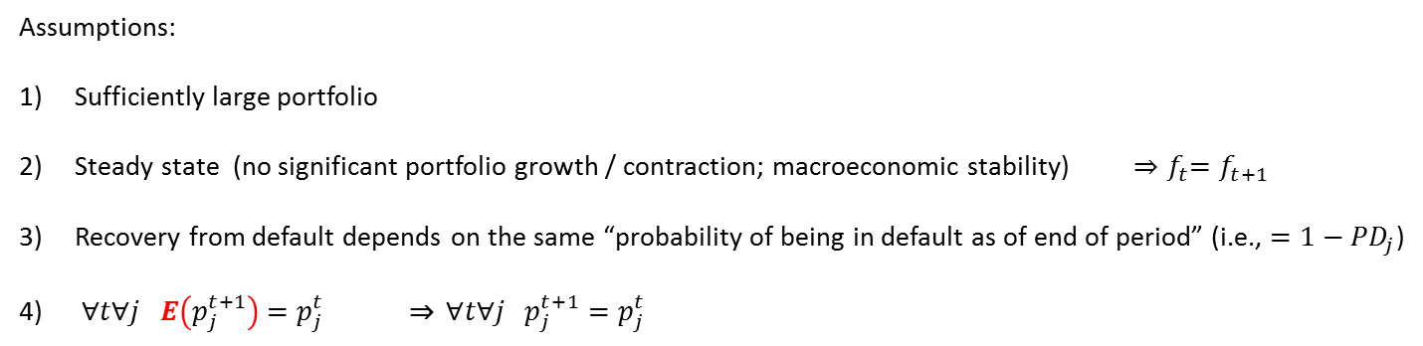



Life-time loss estimation
Lets define, PD estimates a probability of being in default status as of end of period (1 year)
Assumptions:
Sufficiently large portfolio
Steady state (no significant portfolio growth / contraction; macroeconomic stability) ${⇒f}_{t}=f_{t+1}$
Recovery from default depends on the same “probability of being in default as of end of period” (i.e., ${=1−PD}_{j}$)
$∀t∀j E\left(p_{j}^{t+1}\right)$ ${=p}_{j}^{t}$ ⇒ $∀t∀j p_{j}^{t+1}=p_{j}^{t}$
$$f_{t+1}$$
$$p_{t+1}$$
$$f_{t}$$
$$p_{t}$$

Slide 10
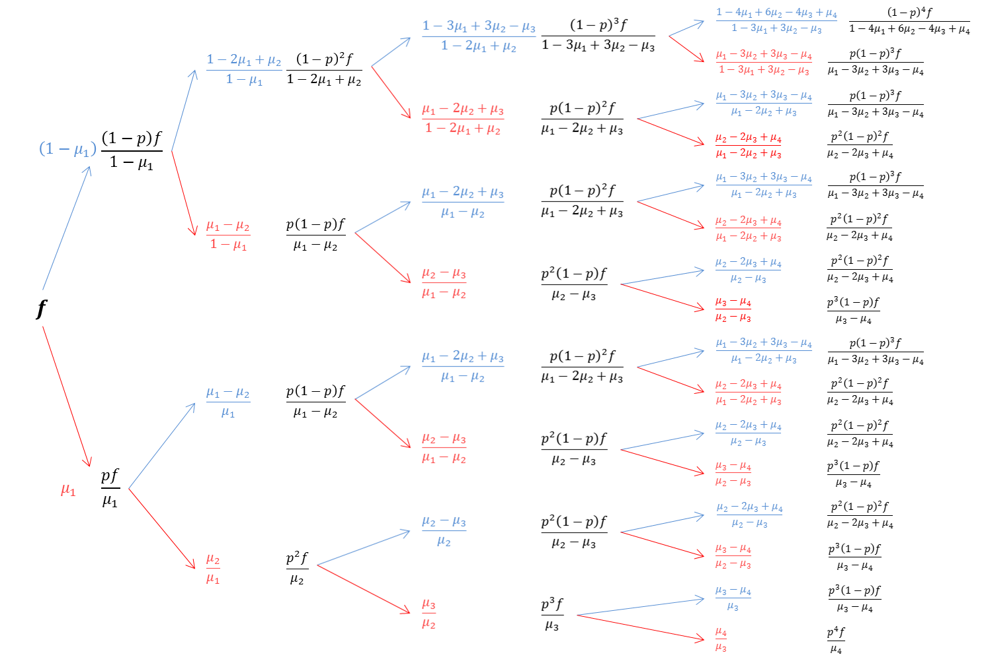
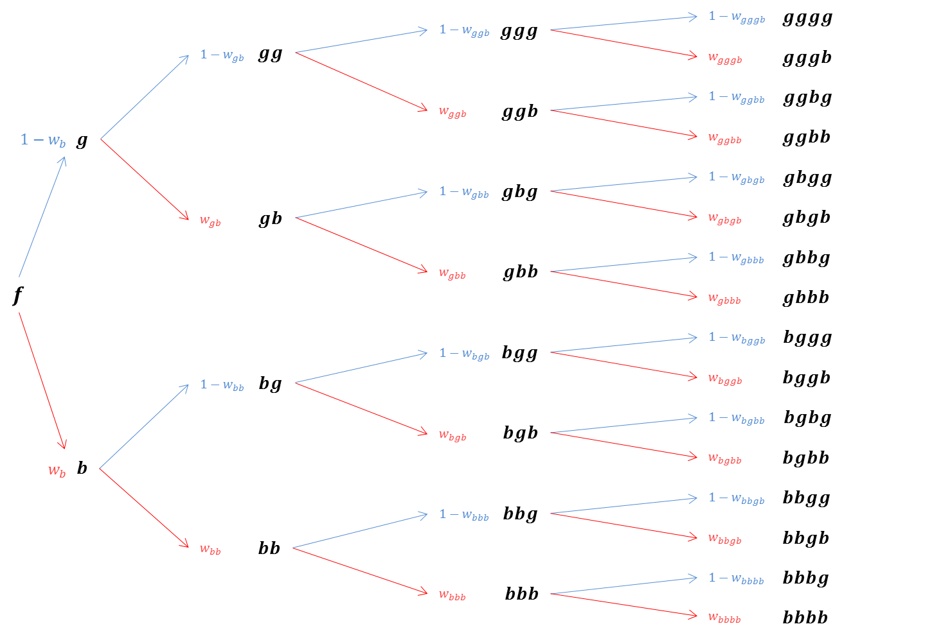




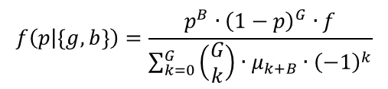



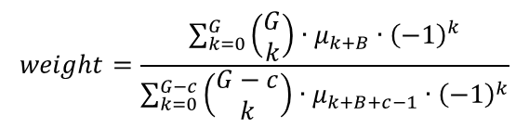

Life-time loss term structure
$$25\%$$
$$f\left(p | \left\{g,b\right\}\right)=\frac{{p^{B}∙\left(1−p\right)}^{G}∙f}{\sum_{k=0}^{G}{\left(\begin{matrix}G \\ k\end{matrix}\right)}∙μ_{k+B}∙{\left(−1\right)}^{k}}$$
$$50\%$$
$$25\%$$
$$weight=\frac{\sum_{k=0}^{G}{\left(\begin{matrix}G \\ k\end{matrix}\right)}∙μ_{k+B}∙{\left(−1\right)}^{k}}{\sum_{k=0}^{G−c}{\left(\begin{matrix}G−c \\ k\end{matrix}\right)}∙μ_{k+B+c−1}∙{\left(−1\right)}^{k}}$$
$$75\%$$
$$25\%$$
where:
$G$ and $B$ are the number of “good” and “bad” periods, respectively;
$c$ is status of the current period:
1, when “good”, and 0, when “bad”;
$μ_{j}$ - $j$^{-th} moment of original $f$distribution.
$$50\%$$
Overdue exposure
at maturity
$$25\%$$
$$100\%$$

Slide 11















Example of Lt EL calculation
Portfolio characteristics:
$μ_{0}=1$
$μ_{1}=0.05$
Life-time Expected Loss:
$p\sim Beta\left(α,β\right)$
Average PD ($μ_{1}$): 5%
$μ_{2}=\text{0.011}\text{2}$
1.67%
Associated Gini: 80%
$μ_{3}=\text{0.003}\text{6}$
4 years till maturity
$μ_{4}=\text{0.001}\text{7}$
$$gggb$$
25%
overdue exposure
2,63%
$$ggbb$$
50%
0,52%
$$gbgb$$
25%
0,52%
$$gbbb$$
75%
0,22%
$$bggb$$
25%
0,52%
$$bgbb$$
50%
0,22%
$$bbgb$$
25%
0,22%
$$bbbb$$
100%
0,17%

Slide 12








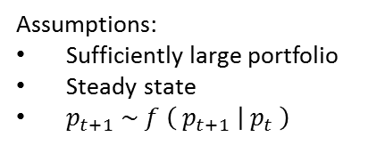


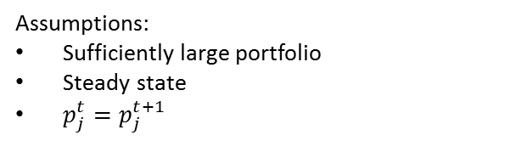



Relaxing assumption: “individual 1-year PD is constant over time”
Assumptions:
Sufficiently large portfolio
Steady state
$p_{j}^{t}=p_{j}^{t+1}$
Assumptions:
Sufficiently large portfolio
Steady state
$p_{t+1} \sim f \left({ p}_{t+1} | { p}_{t} \right)$
$$f_{t+1}$$
$$f_{t+1}$$
$$p_{t+1}$$
$$p_{t+1}$$
$$f_{t}$$
$$f_{t}$$
$$p_{t}$$
$$p_{t}$$
$$f \left({ p}_{t+1} | { p}_{t}={ p}_{0}\right)$$
$${ p}_{0}$$
$$f_{t,t+1}$$
$$f_{t,t+1}$$
… under both sets of assumptions: $f_{t}=f_{t+1}$

Slide 13




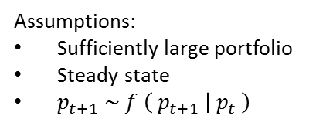



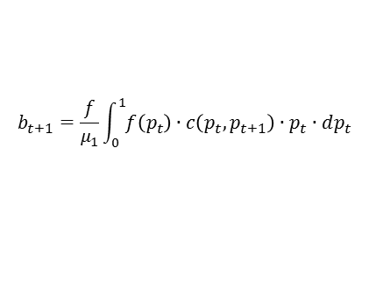
Relaxing assumption: “individual 1-year PD is constant over time”
Assumptions:
Sufficiently large portfolio
Steady state
$p_{t+1} \sim f \left({ p}_{t+1} | { p}_{t} \right)$
$$b_{t+1}$$
$$p_{t+1}$$
$$b_{t+1}=\int_{0}^{1}{f\left(p_{t+1} | p_{t}\right)∙b_{t}∙dp_{t} }$$
$$b_{t}$$
$$p_{t}$$
$$⇒$$
$$b_{t+1}=\frac{f}{μ_{1}}\int_{0}^{1}{f\left(p_{t}\right)∙c\left(p_{t},p_{t+1}\right)∙p_{t}∙dp_{t}}$$
$$f \left({ p}_{t+1} | { p}_{t}={ p}_{0}\right)$$

Slide 14


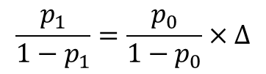



Assumptions related to Expected Value: other occasions
Calibration
In order to meet a specific Central Tendency level, PD can be calibrated in infinitely many ways:
$$p_{1}=p_{0}×∆$$
$$p_{1}=p_{0}+∆$$
$$p_{1}={p_{0}}_{}^{2}+∆$$
$$\ln\left(DR\right)\sim α+β∙Score$$
$$etc.$$
Factually an offset method is based on the following assumption:
$$\frac{p_{1}}{1−p_{1}}=\frac{p_{0}}{1−p_{0}}×∆$$

Slide 15

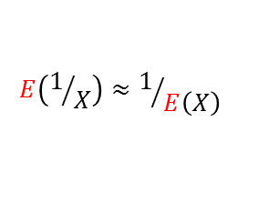



Assumptions related to Expected Value: other occasions
Calibration
“Offset method” assumes:
$$E\left(1/X\right)≈1/{E\left(X\right)}$$
particularly for deriving the parameter “average PD”:
$$\overline{p}=E\left(\frac{1}{1+exp⁡(∙)}\right)≈\frac{1}{E\left(1+exp⁡(∙)\right)}$$
NB: If intrinsic PD really changed by this law:
$$\frac{p_{1}}{1−p_{1}}=\frac{p_{0}}{1−p_{0}}×∆$$
, - then
PD distribution changed as well:
$$f_{cal}=f\left(\frac{p}{p−p∆+∆}\right)$$
And as a result, in general, Gini changed
$$Gini(f)≠Gini(f_{cal})$$

Slide 16
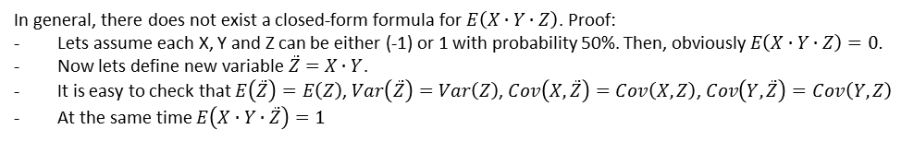
Assumptions related to Expected Value: other occasions
Expected Loss formula
Expected Loss:
$$E\left(PD∙LGD∙EAD\right)≈E\left(PD\right)∙E\left(LGD\right)∙E\left(EAD\right)$$
In general, there does not exist a closed-form formula for $E\left(X∙Y∙Z\right)$ (proof in footnotes)
However, we can approximate the formula very well:
$$E\left(PD∙LGD∙EAD\right)$$
$≈$ $E\left(PD\right)∙E\left(LGD\right)∙E\left(EAD\right)+E\left(PD\right)∙Cov\left(LGD,EAD\right)+E\left(LGD\right)∙Cov\left(PD,EAD\right)+E\left(EAD\right)∙Cov\left(LGD,PD\right)$
Approximation deviates from factual EL not more than +/- 1% in 99.9% possible dependency structures.
In general, there does not exist a closed-form formula for $E\left(X∙Y∙Z\right)$. Proof:
Lets assume each X, Y and Z can be either (-1) or 1 with probability 50%. Then, obviously $E\left(X∙Y∙Z\right)=0.$
Now lets define new variable $\ddot{Z}=$ $X∙Y$.
It is easy to check that $E\left(\ddot{Z}\right)=E\left(Z\right)$, $Var\left(\ddot{Z}\right)=Var\left(Z\right)$, $Cov\left(X,\ddot{Z}\right)=Cov\left(X,Z\right)$, $Cov\left(Y,\ddot{Z}\right)=Cov\left(Y,Z\right)$
At the same time $E\left(X∙Y∙\ddot{Z}\right)=1$

Slide 17
Beautiful interlinks in credit scoring
Thanks for your interest !
Your questions are welcome !

